Slide 1
Errors in Digitization in GIS and Automatic Methods for Their Elimination
This presentation explores the challenges of digitizing spatial data in Geographic Information Systems (GIS), focusing on common errors and the latest automated methods for their detection and correction. We will review error types, methodologies, real-world results, and practical recommendations for improving data integrity and efficiency in GIS workflows.

Slide 2
Understanding Digitization Errors in GIS
Geometric/Topological Errors
Attribute & Logical Errors
Dangle errors
Missing or duplicate identifiers
Overshoots & undershoots
Multiple IDs in one feature
Sliver polygons
Labels outside boundaries
Intersection & near element errors
Overlapping polygons & gaps
Duplicate or zero-length features
Self-intersecting features

Slide 3
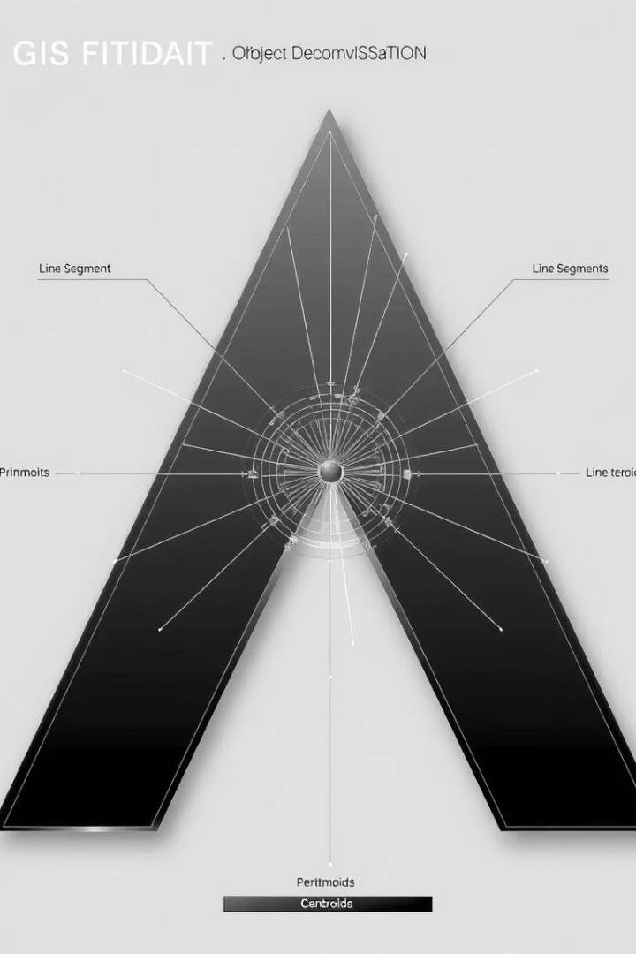
Methodology: Primitive-Based Editing Approach
1
Object-Based Editing
2
Primitive-Based Editing
Edits entire objects in CAD, but is resource-intensive and complex for large datasets.
Preferred method: breaks objects into segments and centroids, enabling ongoing topology validation and faster error detection.
3
Adopted Workflow
Focuses on editing primitives for efficiency, especially in large-scale cadastral and land parcel datasets.

Slide 4





Workflow: From Data Import to Validation
Data Import & Standardization
Gather data in SHP, XML/GML, or CSV; transform to a common coordinate system and assign unique IDs.
Decomposition
Convert features into line segments and centroids for efficient processing.
Topology Verification
Classify and detect geometric, attribute, and logical errors using algorithms.
Error Correction
Apply automated fixes and flag sensitive cases for manual review.
Export & Final Validation
Export corrected data to standard formats and verify topological integrity.

Slide 5



Automated Error Detection Techniques
Geometric Checks
Detect dangles, intersections, and near element errors by measuring distances and intersections.
Attribute Validation
Identify missing, duplicate, or misplaced identifiers using spatial and attribute queries.
Logical Consistency
Find redundant segments, self-intersections, and violations of topology rules using automated algorithms.

Slide 6



Correction Methods: Automation and Review
Attribute Corrections
2
Assign or remove identifiers
Relocate labels inside features
Automatic Fixes
Remove dangles and slivers
1
Insert nodes at intersections
Manual Review
Snap and merge features
Flag sensitive or ambiguous cases
3
Ensure legal and cadastral accuracy

Slide 7
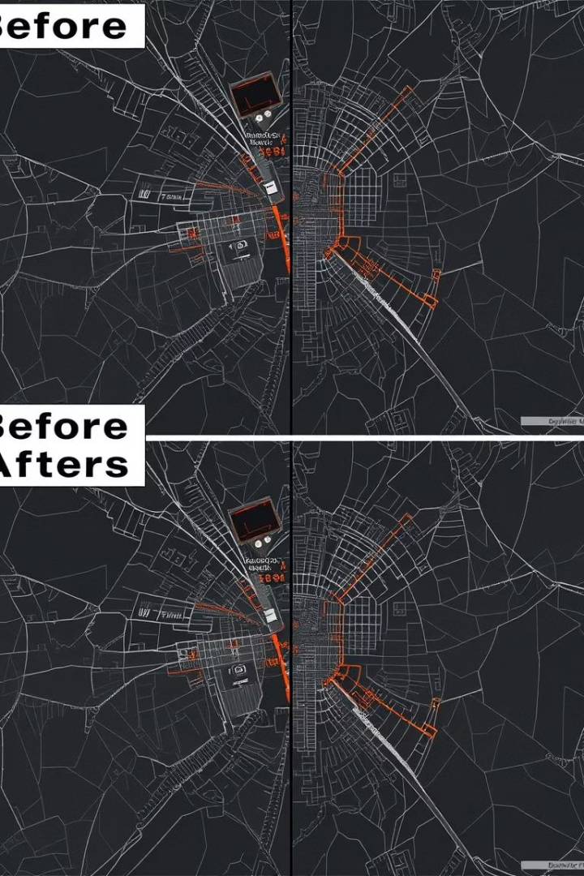
Results: Error Detection and Correction Rates
134
Dangle Errors
129 corrected automatically, 5 required manual review.
87
Overshoots
85 fixed automatically, 2 left for review.
61
Sliver Polygons
All 61 corrected automatically.
95%
Overall Success
Over 95% of errors resolved automatically; less than 5% required human intervention.

Slide 8
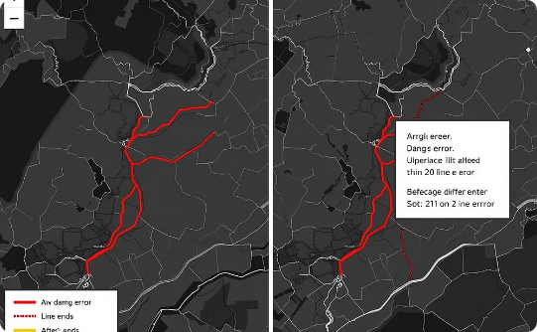
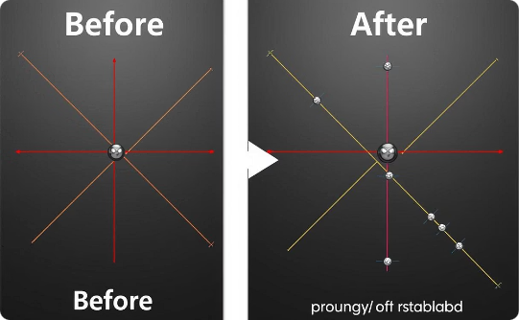
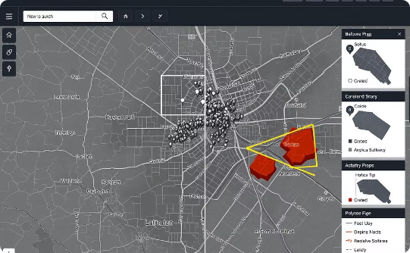
Visualizing Common Errors and Corrections
Dangle Error Correction
Intersection Error Correction
Identifier Error Correction
Loose line ends are connected or removed to restore topology.
Intersections are fixed by inserting shared nodes at crossing points.
Duplicate or misplaced identifiers are resolved for accurate data association.

Slide 9
Discussion: Effectiveness and Limitations
High Efficiency
Visual Support
Automatic methods corrected most errors quickly, especially in large datasets like LPIS.
Before-and-after figures provided intuitive understanding and validation of corrections.
Limitations
Recommendations
Complex or ambiguous cases, such as merging near features or missing IDs, still require human oversight and careful rule setting.
Integrate AI/ML, interactive validation, and dynamic rules for smarter, more adaptive error handling.

Slide 10
Conclusion and Future Directions
Summary
Digitization errors in GIS can undermine spatial analysis and decision-making if left uncorrected.
Automated Solutions
Rule-based and primitive-based methods correct over 95% of errors, improving data quality and scalability.
Path Forward
Adopting automated correction as a standard, with human review for edge cases, will enhance GIS reliability across disciplines.

